Slide 1
Contact Management UI Refresh Communication
Genesys Cloud Product Management

Slide 2
Introduction
We are increasing the number of outcomes allowed per organisation to 100. This will allow organisations to track outcomes at a more granular level.
To facilitate this change, we have added a toggle to the outcome configuration page to allow users to enable or disable outcome scoring.
Highlights of this change include:
Increasing the number of overall outcomes to 100
Giving users flexibility when enabling outcome scoring
No change to existing outcome configuration

Slide 3
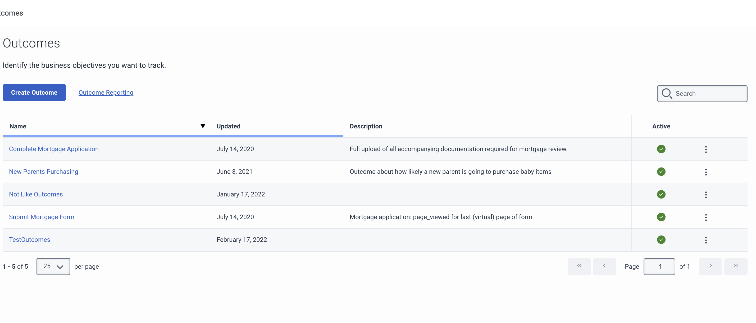
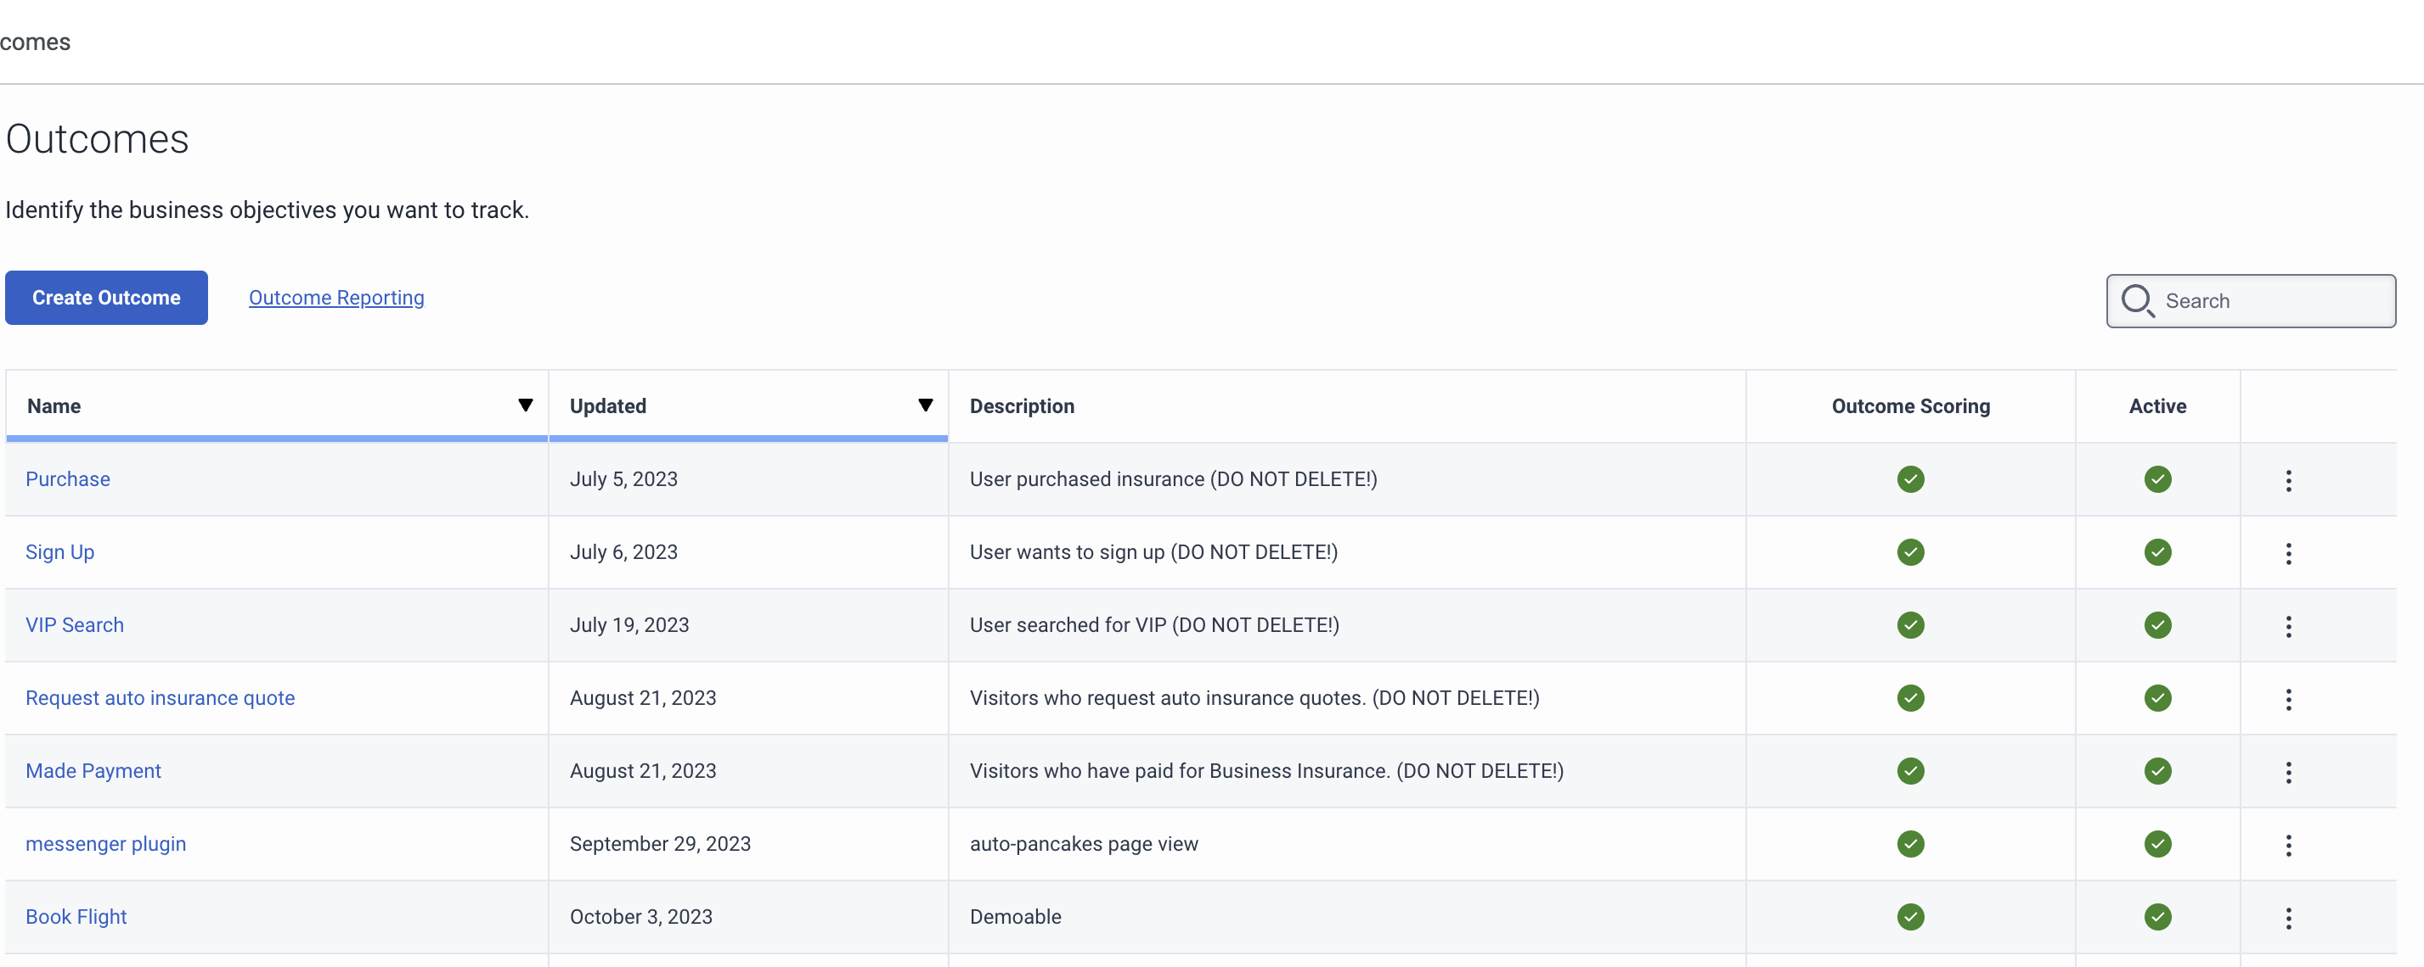
Before and after: Outcomes list view
Before
After
Addition of an Outcome Scoring status column

Slide 4
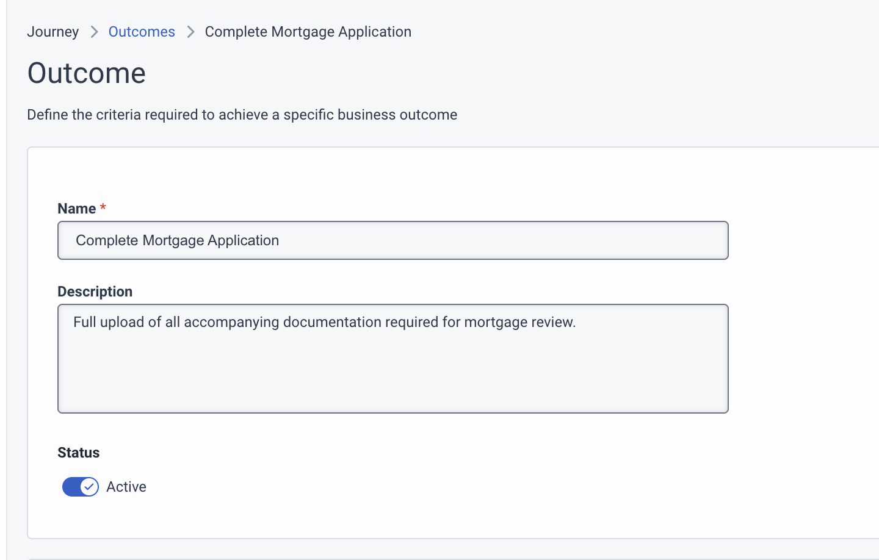
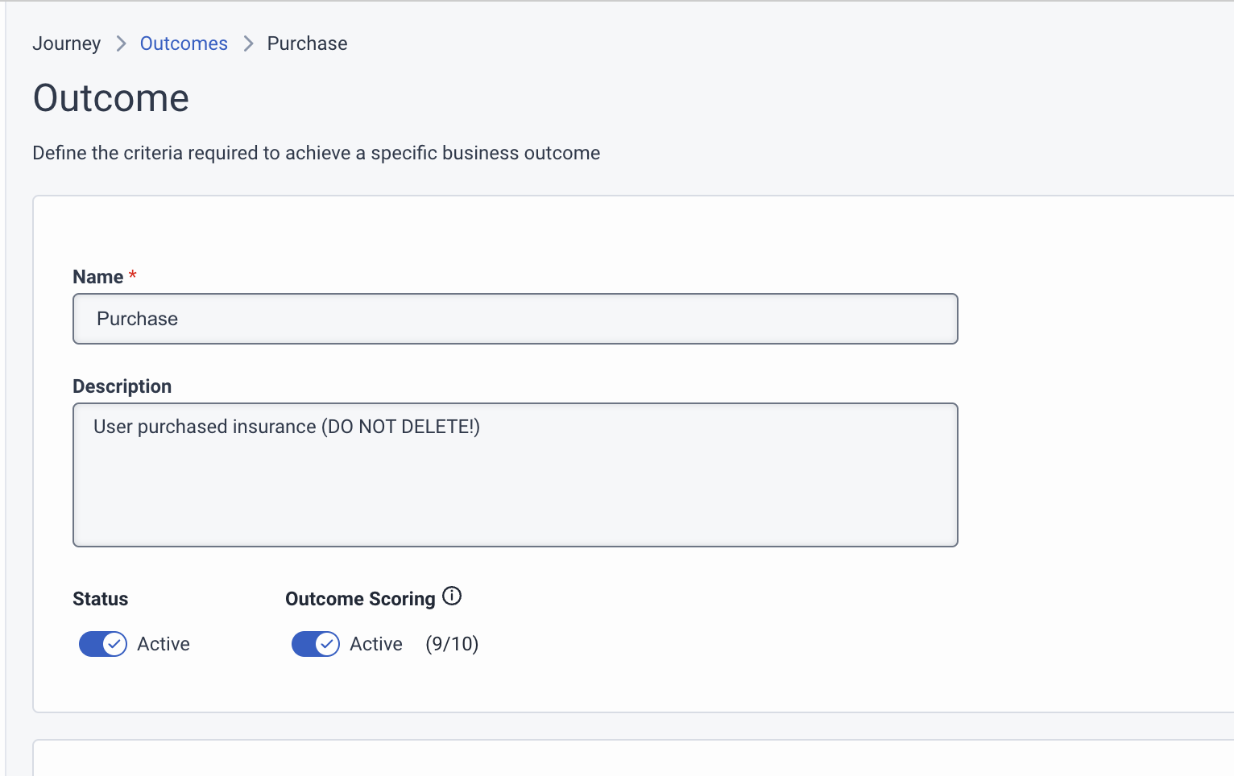
Before and after: Outcome Configuration Page
Before
After
Addition of an Outcome Scoring toggle.

Slide 5
Thank you

