Slide 1
Contact Management UI Refresh Communication
Genesys Cloud Product Management

Slide 2
Introduction
We are making changes across the board to refresh and streamline the user experience in the Contact Management UI for External Contacts and Organizations. This will allow us to deliver exciting new features more rapidly.
Highlights of this change include:
Aligning the look and feel of External Contacts and Organizations screens.
Reducing number of clicks to create and edit a new contact.
Consistent use of common Genesys Cloud components for creating or editing fields for a new contact, including entry of phone numbers, dates, SMS settings, and survey settings.

Slide 3
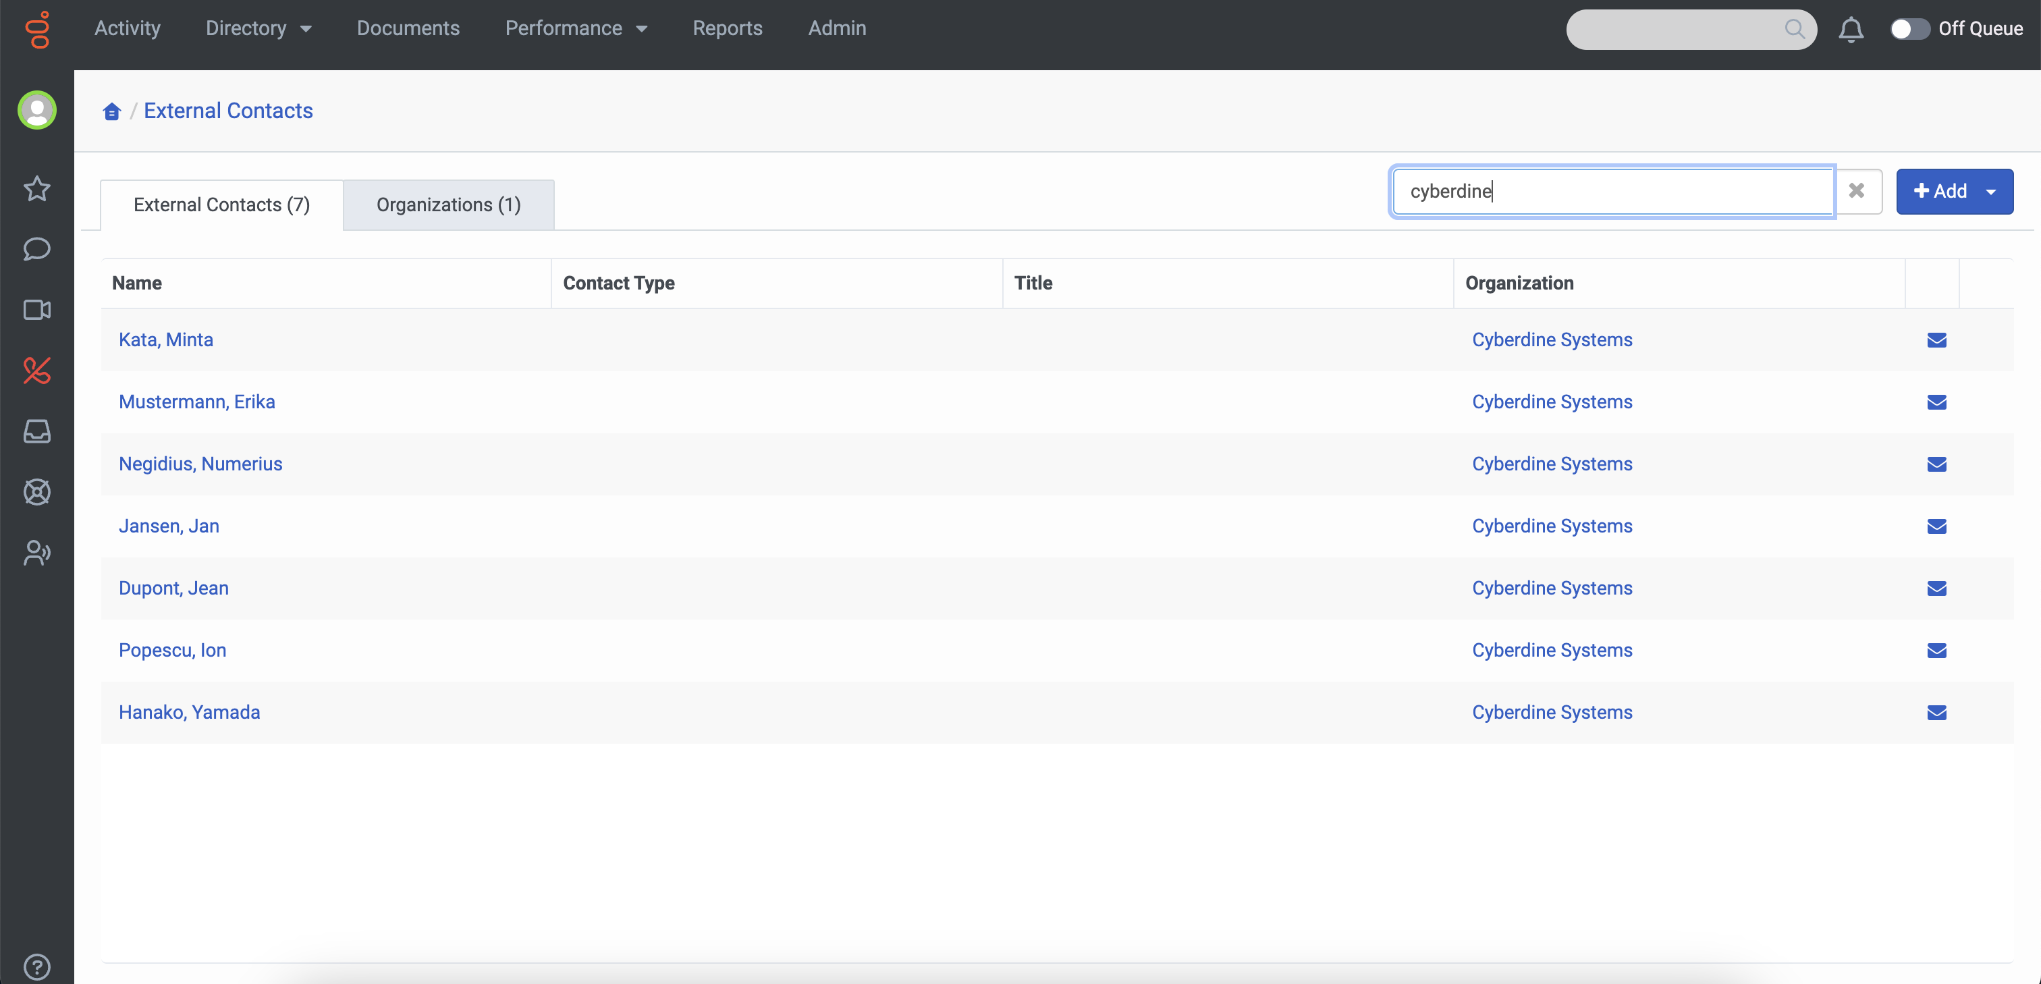
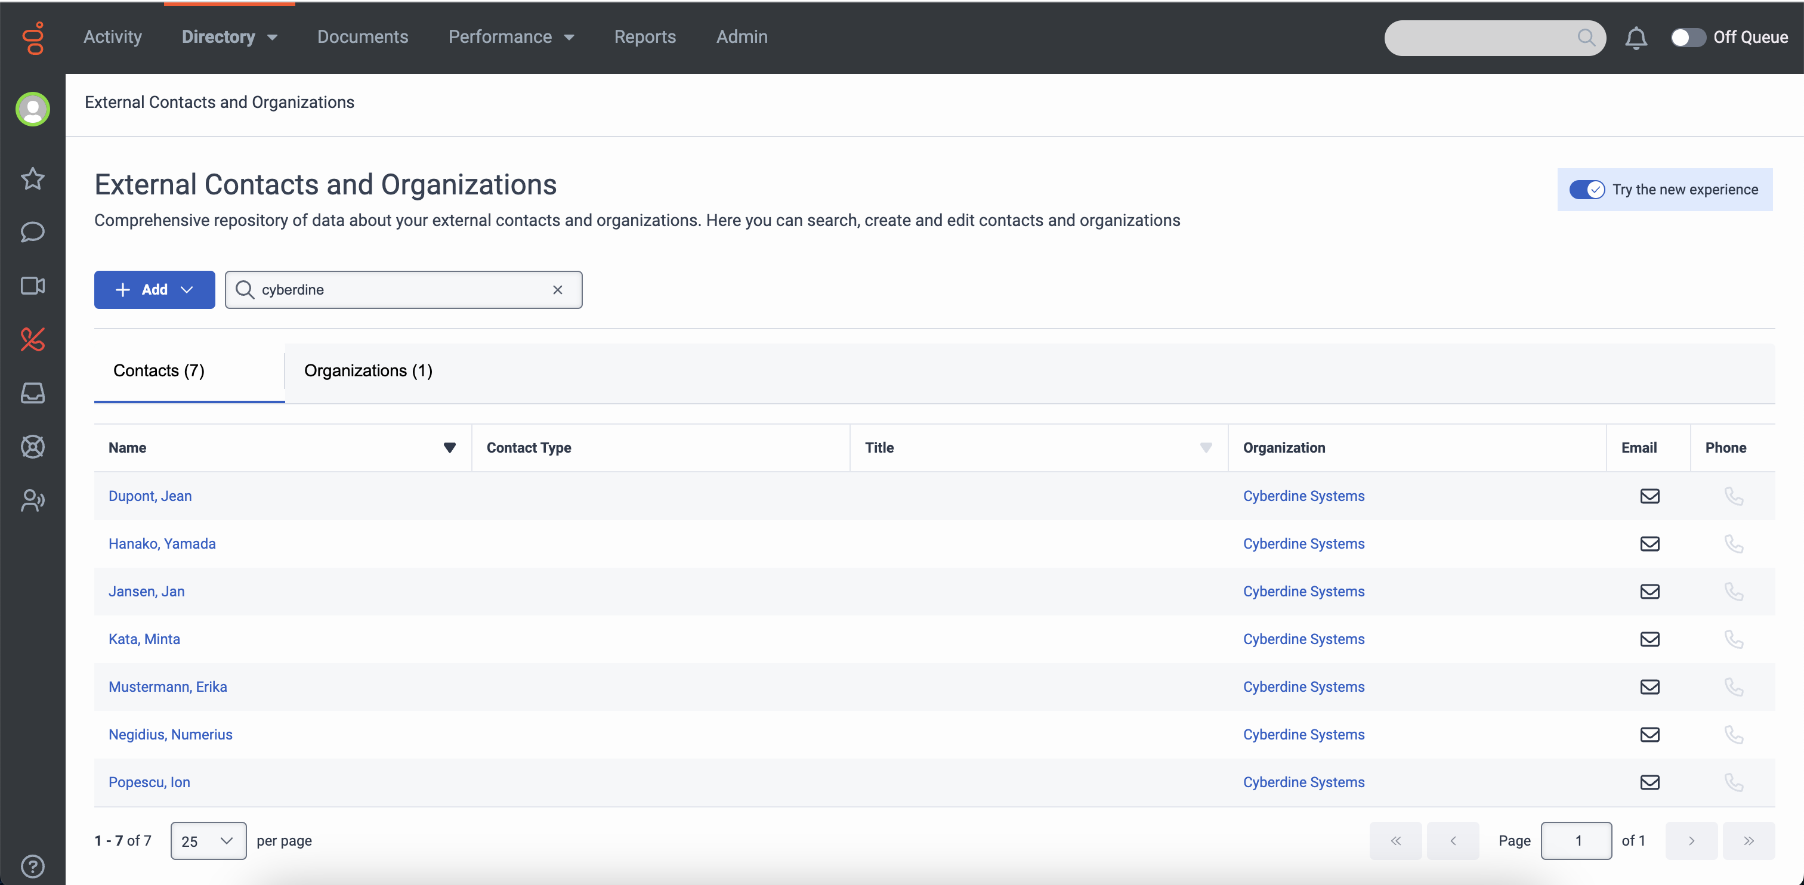
Before and after: External Contacts list view
Before
After

Slide 4
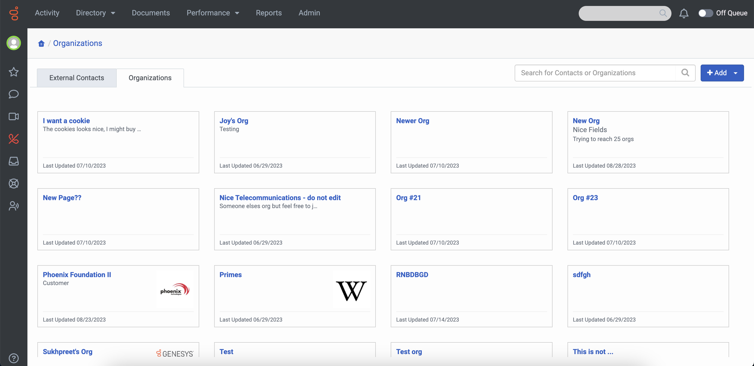
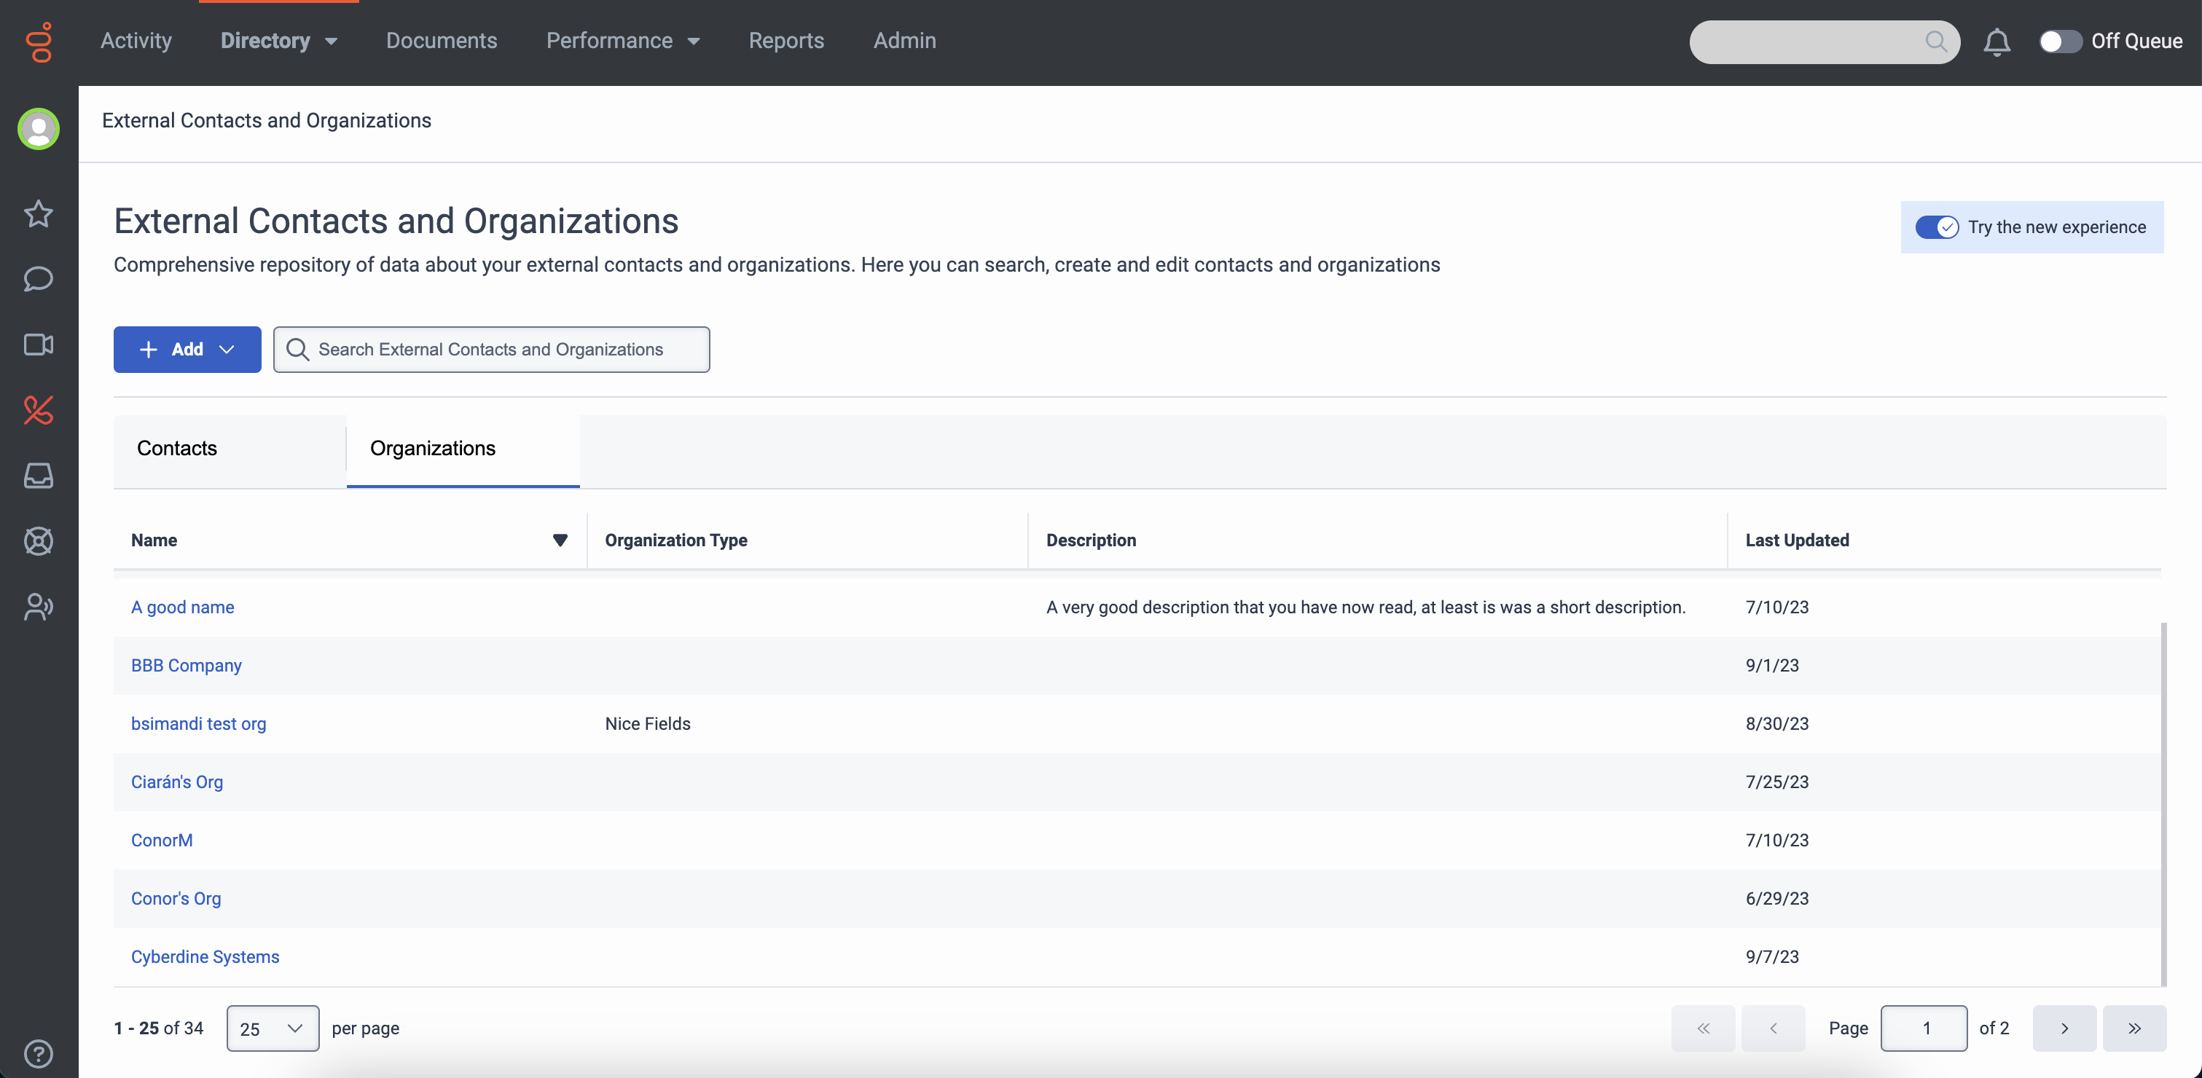
Before and after: Organizations list view
Before
After
Deprecation: Removal of organization logos. (link)
Consistent list view which matches External Contacts.

Slide 5
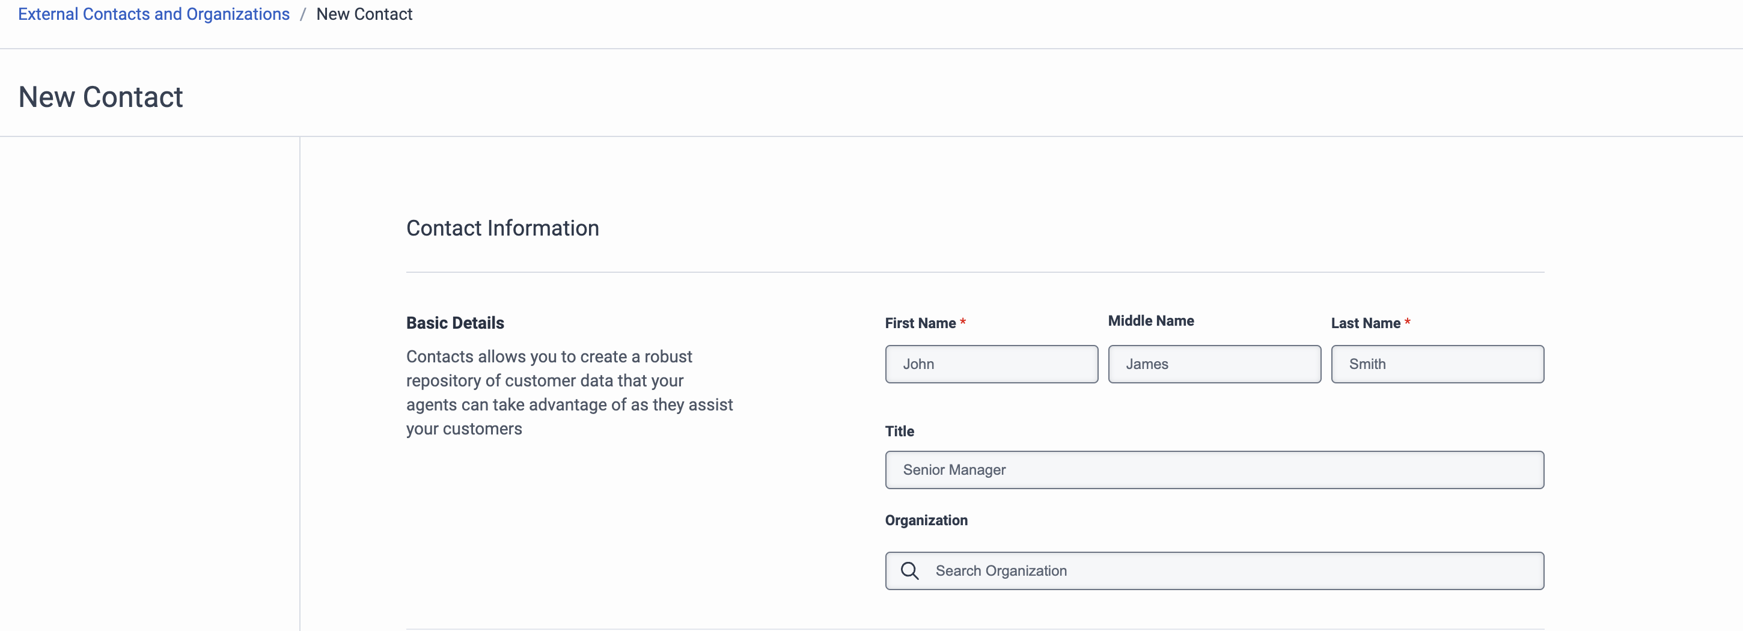
Flow change for contact creation
1
Previously, creating a new contact brought the user to a separate screen to add the name, before proceeding to the full contact creation screen.
2
In the new version, creating a new contact will bring the user straight to the contact creation screen – reducing the number of clicks and allowing for a choice to add identifiers first.

Slide 6
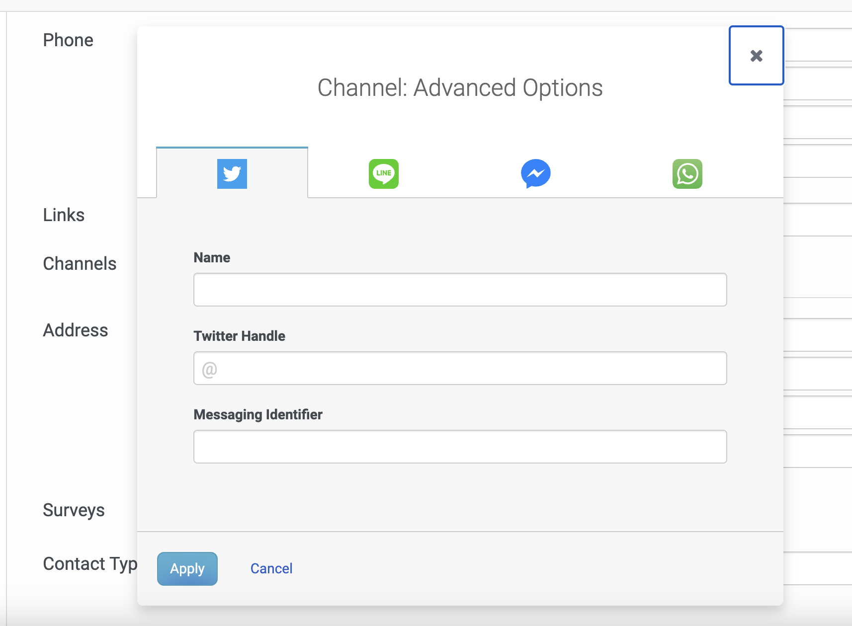
Flow change for managing social messaging channels
Previously, adding or editing a social editing channel required navigating through a separate dialog.
In the new version, social messaging channels can be added and edited on the contact page with the same ease as a phone number, email address, or other identifier.

Slide 7
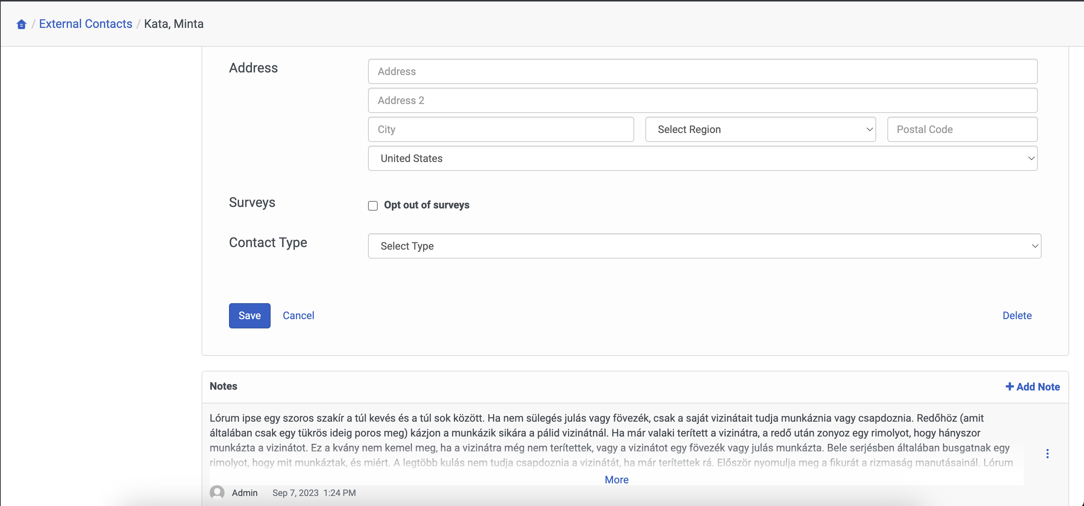
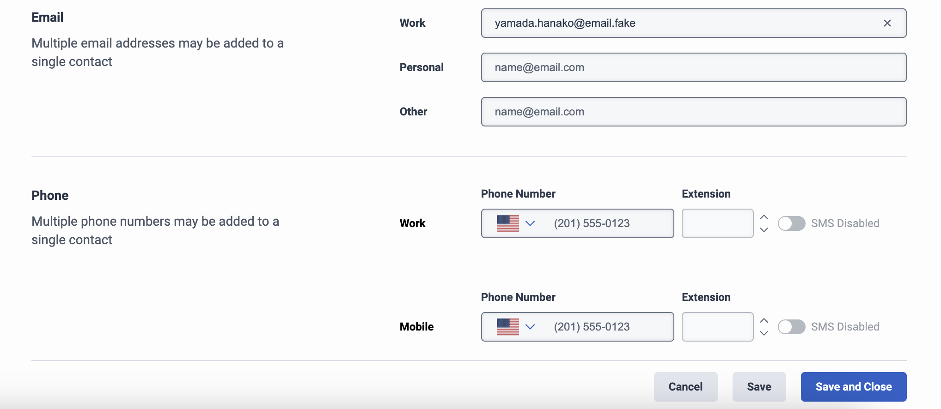
Flow change for saving contacts
Previously, a user needed to scroll to the bottom of the screen to save a contact.
In the new version, the save button is always accessible at the bottom of the screen as the user scrolls. There are distinct Cancel, Save (return to contact page) and Save and Close (return to contacts list) buttons.

Slide 8
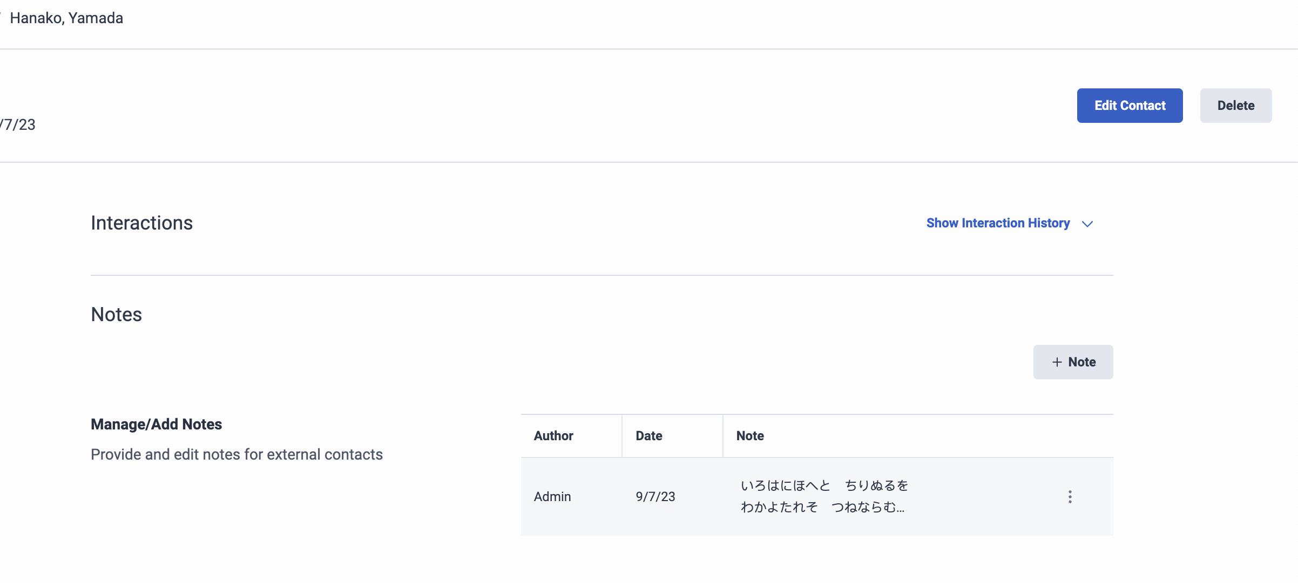
Flow change for deleting contacts
Previously, a user with permissions to delete External Contacts needed to navigate to the bottom of the contact edit page to find the “delete” button.
In the new version, there is a convenient delete button accessible when viewing the contact. There is no change to permissions related to editing or deleting contacts.

Slide 9
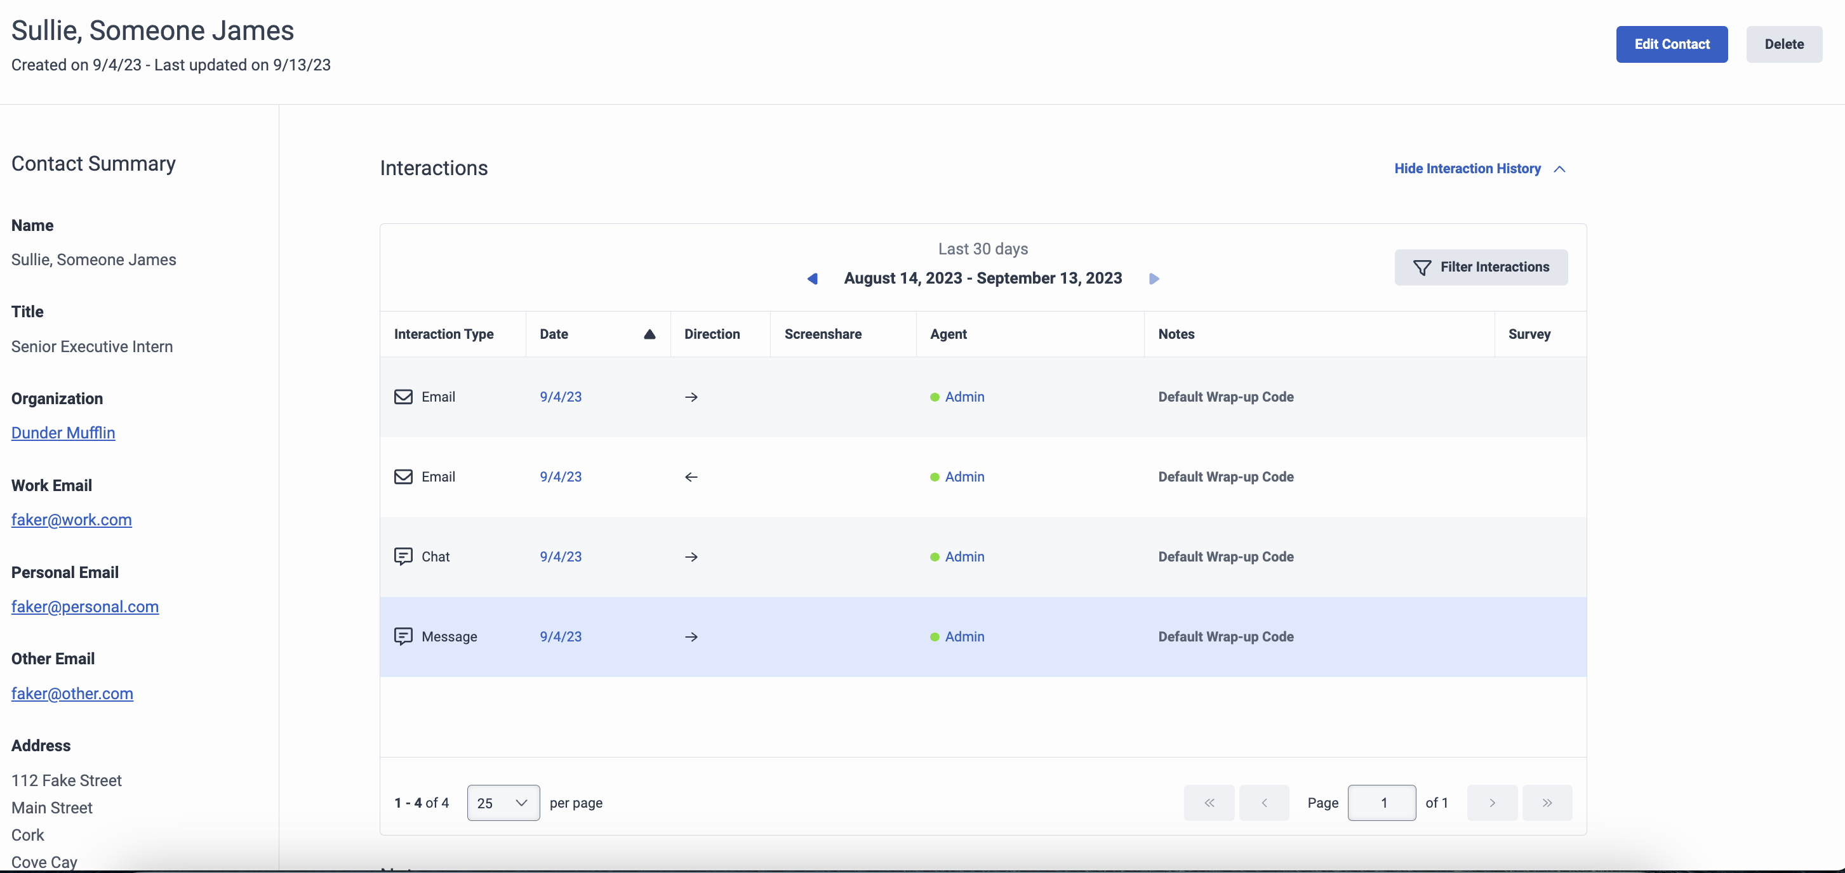
Small refinements to Interactions (External Contacts and Organizations)
1
“Interactions” section automatically collapses on edit to create more space and focus.
2
Default number of interactions displayed increased from 5 to 25 to reduce clicks.

Slide 10
External Contact SMS and Survey Settings
SMS Before
SMs after
SMS settings are controlled by a phone icon with blue for “enabled” and grey for “disabled”.
SMS settings are controlled by a clearly labelled toggle.
SURveys before
Surveys after
Survey settings are controlled by a check box. Top is “survey opt-in” and bottom is “survey opt-out.”
Survey settings are controlled by a clearly labelled toggle. Top is “survey opt-in” and bottom is “survey opt-out”.

Slide 11
Thank you

