Slide 1
Case Management

Slide 2
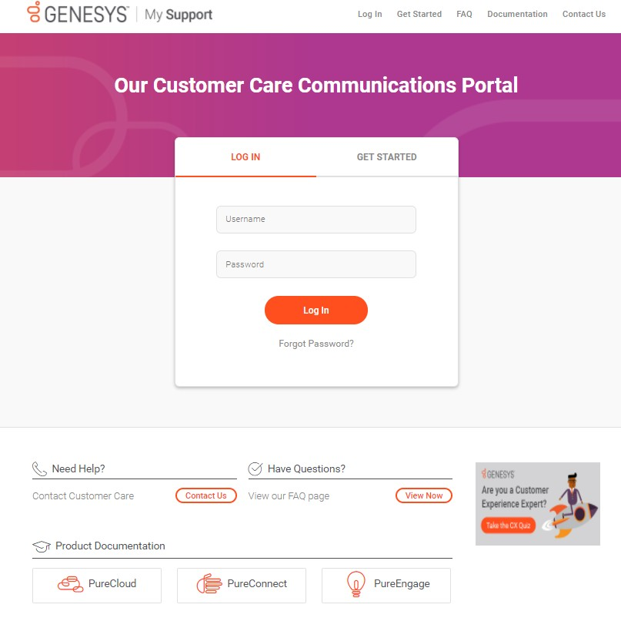
My Support: Login from the Customer Care Website
http://www.genesys.com/customer-care
Login to My Support:
To open a Support Case
To update/manage open Support Cases
Access Product Documentation
See Customer Care News and
Product Advisories
To manage your My Support profile and access privileges
My Support Login
From this page, you can also:
Contact Customer Care
View our FAQ page
Visit the Product Documentation sites
Genesys confidential and proprietary information.
Unauthorized disclosure is prohibited.

Slide 3
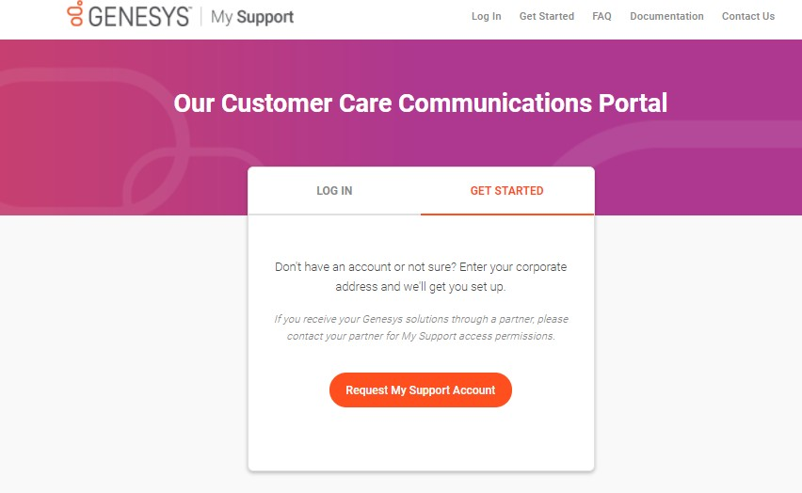

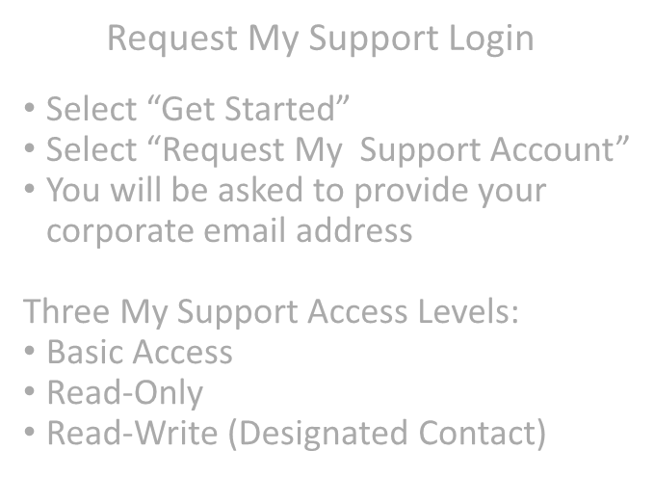


My Support: Request an Account
http://www.genesys.com/customer-care
Request My Support Login
Select “Get Started”
Select “Request My Support Account”
You will be asked to provide your corporate email address
Three My Support Access Levels:
Basic Access
Read-Only
Read-Write (Designated Contact)

Slide 4
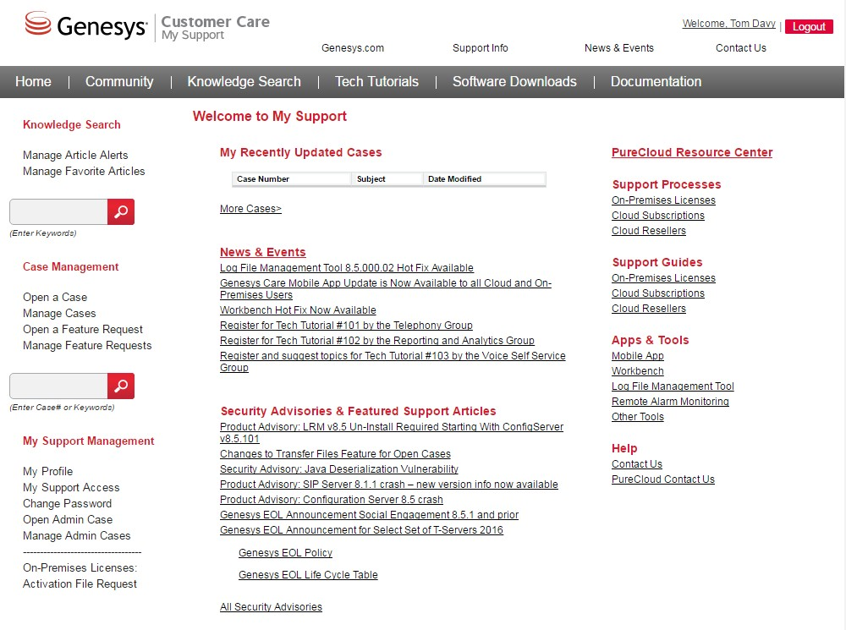




My Support: Home
Access many My Support features from the Home page or the top menu bar
Recent Cases at-a-glance
Featured News, upcoming events, and important Security Advisories and Support Articles will display on the home page

Slide 5


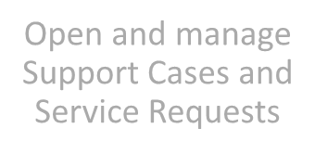

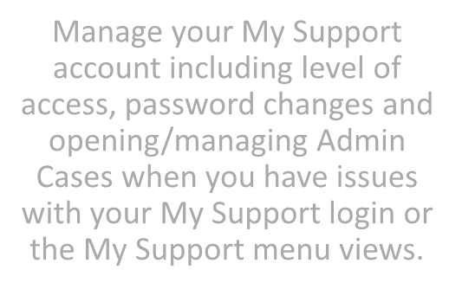


My Support: Home
My Support left-menu links for PureCloud
Open and manage Support Cases and Service Requests
Manage your My Support account including level of access, password changes and opening/managing Admin Cases when you have issues with your My Support login or the My Support menu views.

Slide 6
Tips: What to Check before Opening a Case
If you are experiencing a problem:
Conduct these quick troubleshooting actions:
Refresh the browser or desktop app.
Log out and back in.
Clear the browser cache and refresh again.
Verify that the problem occurs on another workstation.
Verify that the problem occurs for another user.
Turn the workstation off and on again.
If the problem still exists, ask yourself these additional questions and provide what information you can when you submit a support case:
Have you been able to reproduce the problem (if so, please document the steps)?
Have you identified a clear business impact?
Have you described what actions you have taken so far in attempting to solve the problem?

Slide 7

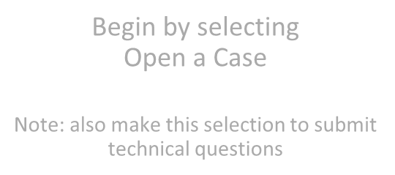

My Support: Opening a Support Case
Access many My Support features from the Home page or the top menu bar
Begin by selecting
Open a Case
Note: also make this selection to submit technical questions

Slide 8
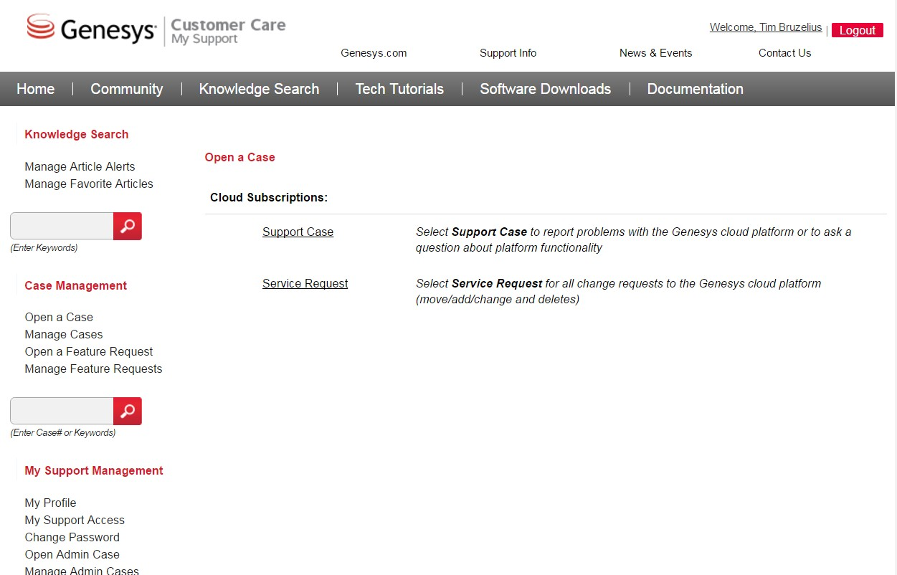

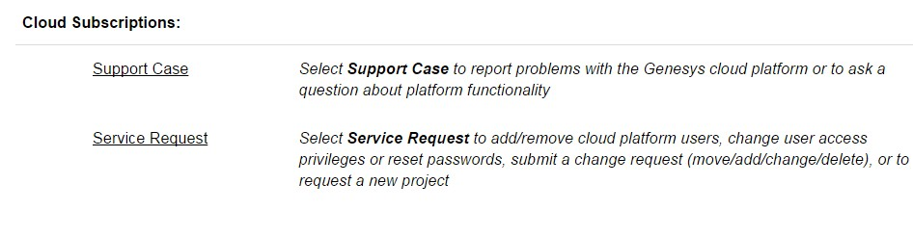


My Support: Opening a Support Case
Select Support Case

Slide 9
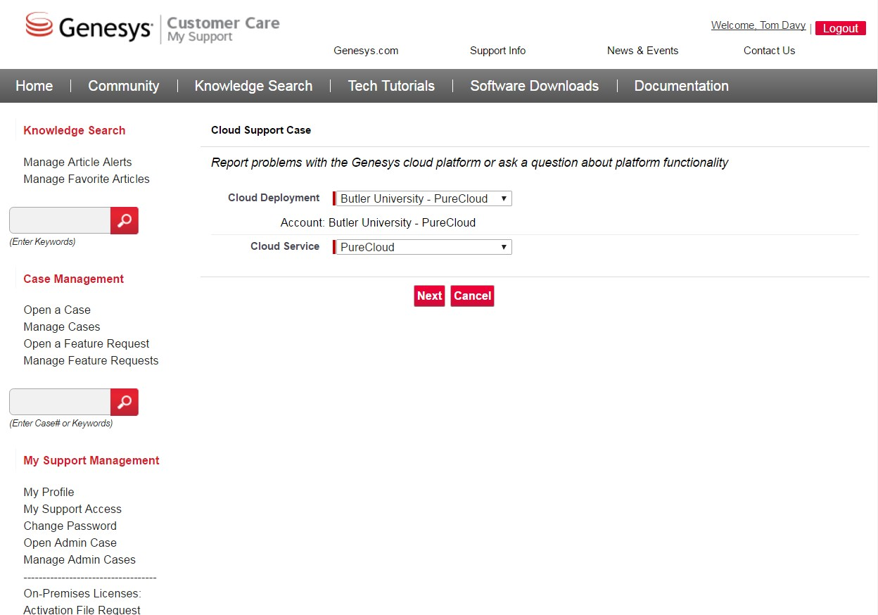
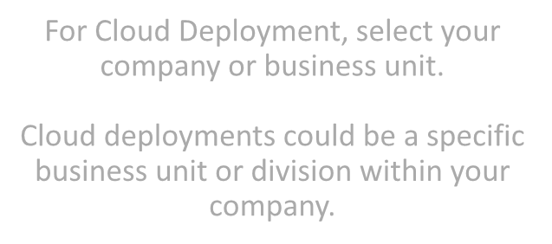




My Support: Opening a Support Case
Your Company
For Cloud Deployment, select your company or business unit.
Cloud deployments could be a specific business unit or division within your company.
Defaults to PureCloud

Slide 10
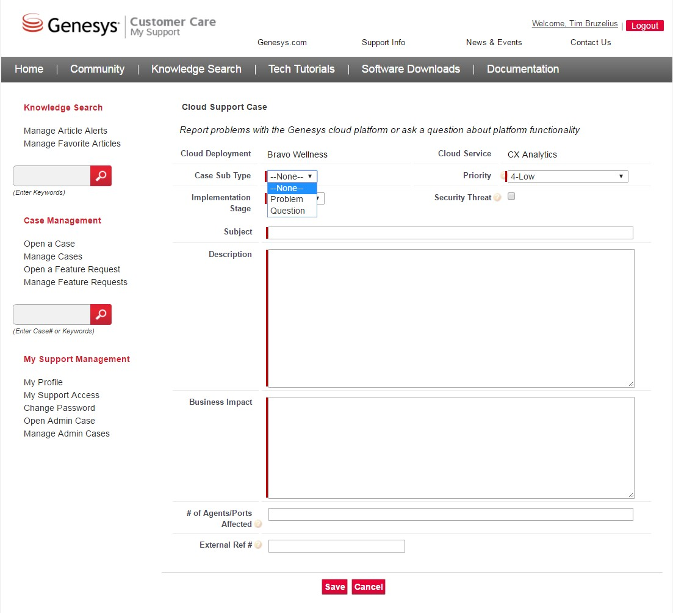

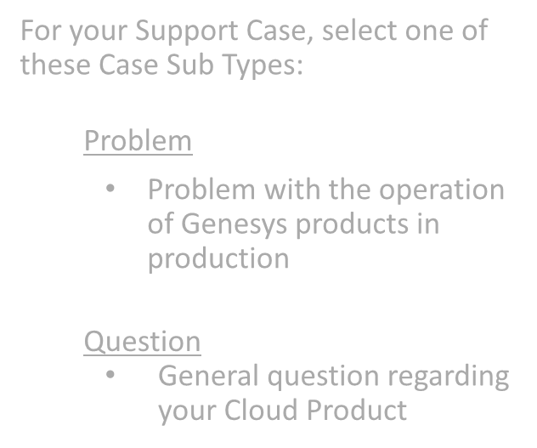
My Support: Opening a Support Case
For your Support Case, select one of these Case Sub Types:
Problem
Problem with the operation of Genesys products in production
Question
General question regarding your Cloud Product

Slide 11
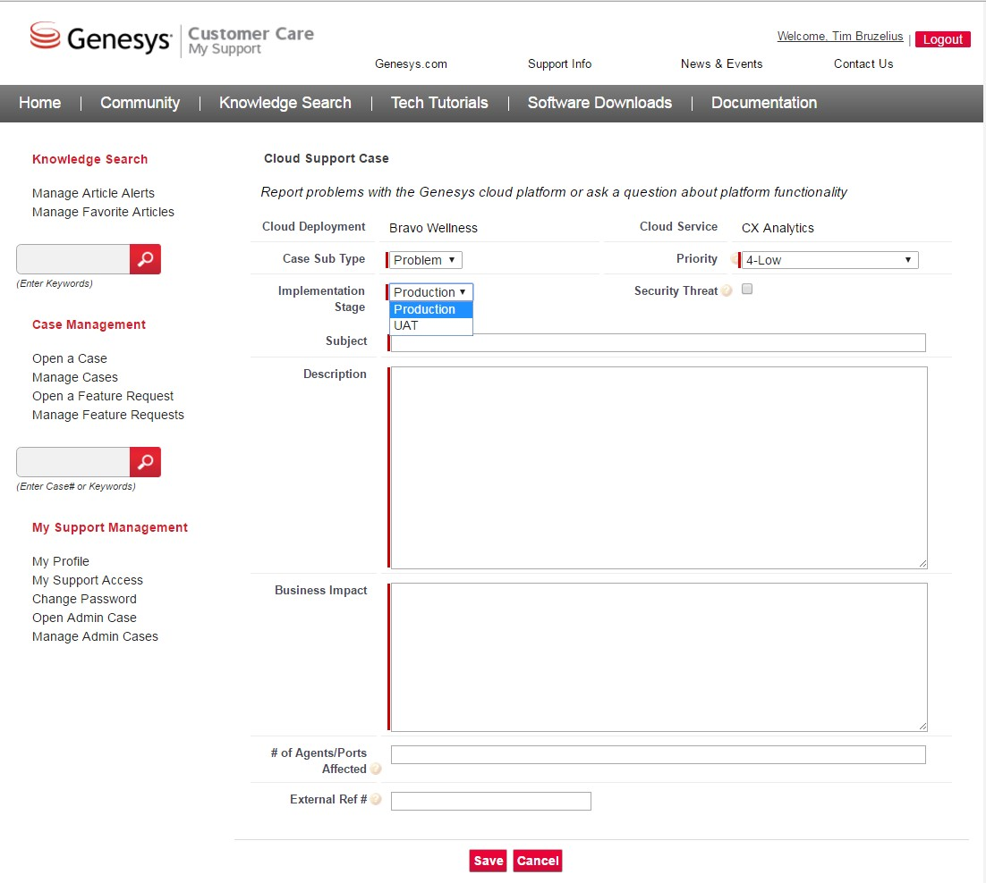

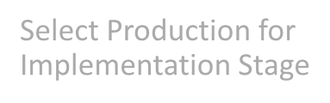
My Support: Opening a Support Case
Select Production for
Implementation Stage

Slide 12
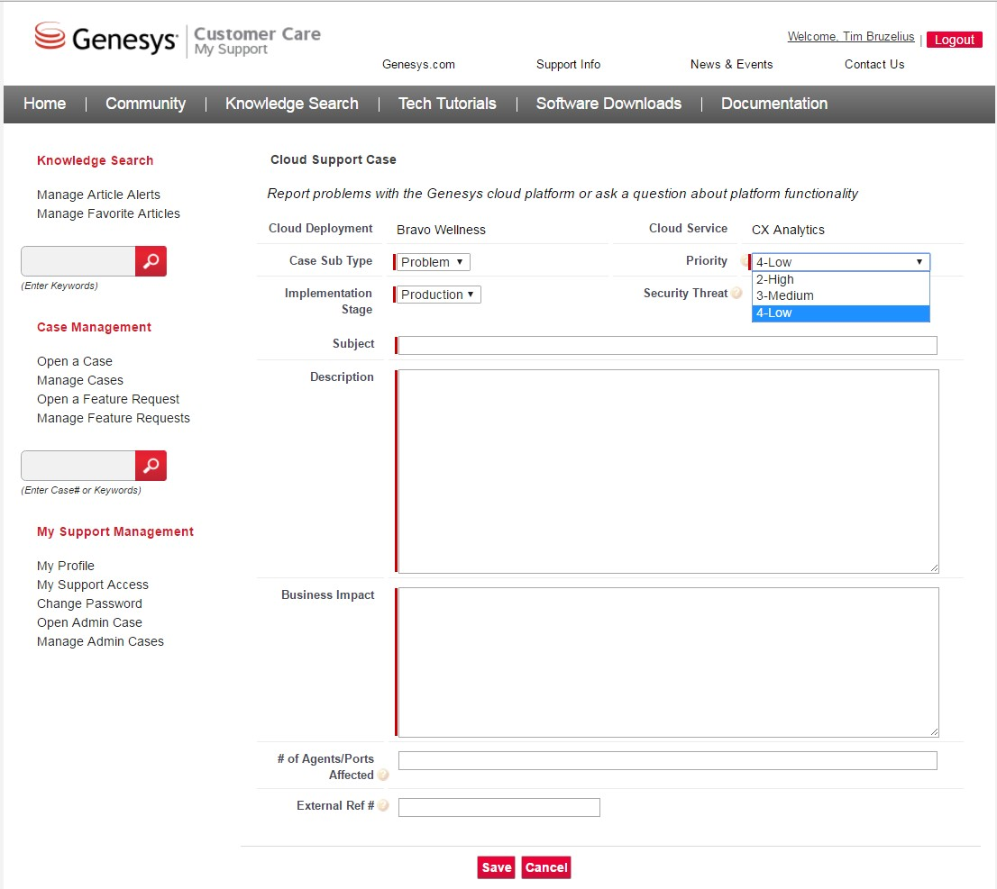

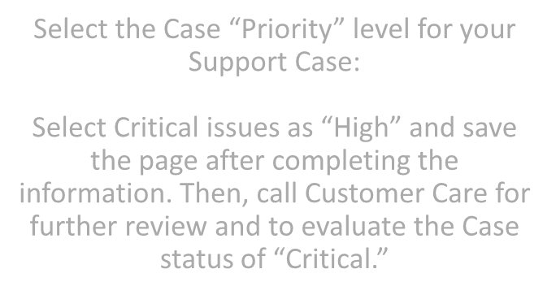

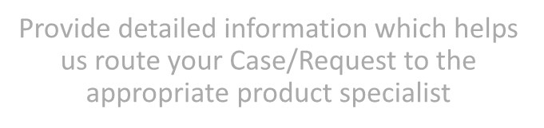
My Support: Opening a Support Case
Visit PureCloud Service Level Agreements
for Case Priority Definitions
Select the Case “Priority” level for your
Support Case:
Select Critical issues as “High” and save the page after completing the information. Then, call Customer Care for further review and to evaluate the Case status of “Critical.”
Provide detailed information which helps us route your Case/Request to the appropriate product specialist

Slide 13
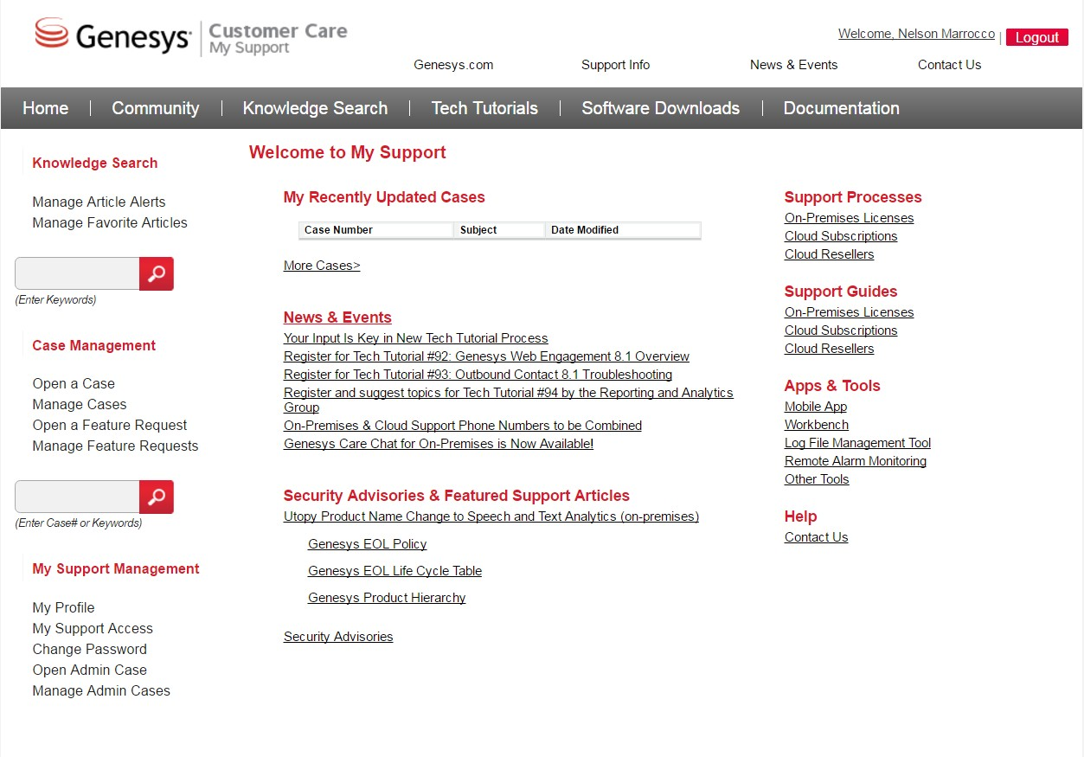

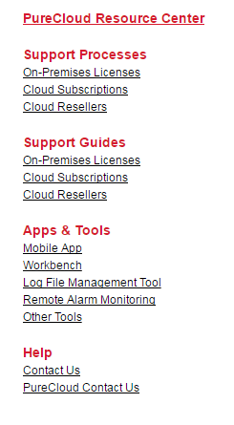
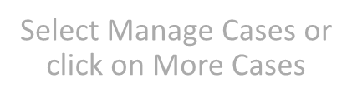

My Support: Managing Your Support Cases
Select Manage Cases or
click on More Cases

Slide 14
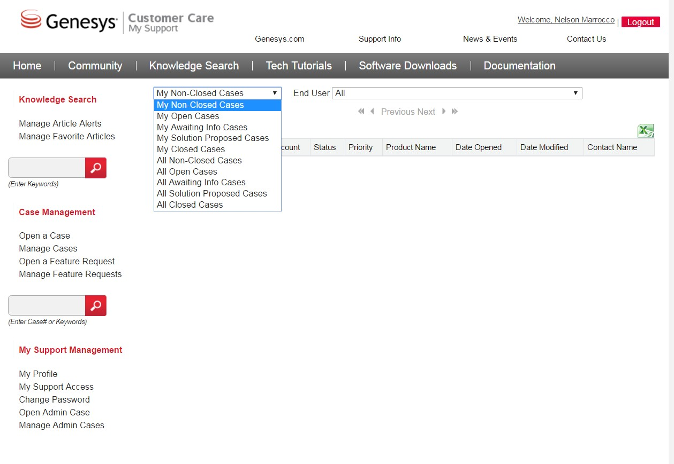

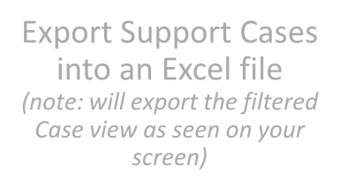


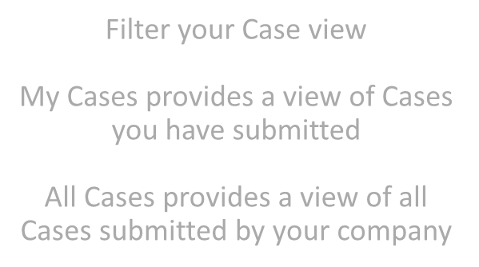
My Support: Managing Your Support Cases
Export Support Cases into an Excel file
(note: will export the filtered Case view as seen on your screen)
Filter your Case view
My Cases provides a view of Cases you have submitted
All Cases provides a view of all Cases submitted by your company

Slide 15
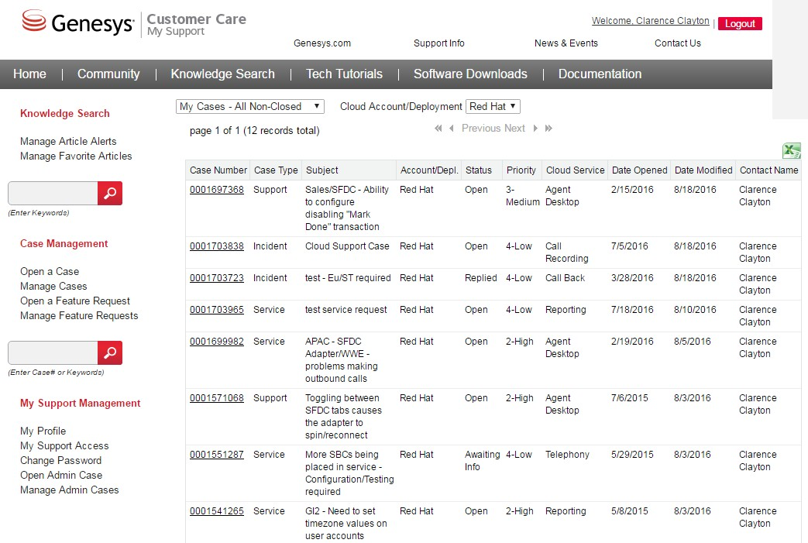

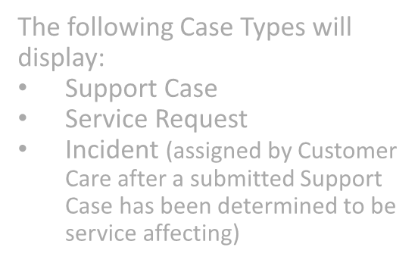
My Support: Managing Your Support Cases
◆ Case Number: Assigned by Customer Care
Case Type: see grey box
⬥ Subject: Description of Case
 Account/Depl: Cloud Deployment
 Status: Current status of the case
OPEN (New, Investigation, Customer Responded) AWAITING INFO (Info Required from Customer) SERVICE RESTORED (Pending Permanent Solution, Pending RCA)
REPLIED (Resolved; Solution Proposed)
CLOSED (Cancelled; Resolved; Redirected)
 Priority: Assigned per case severity; see slide 13
 Cloud Service: Affected cloud service
 Date Opened: Date Case opened
 Date Modified: Last date that either Genesys or customer posted a case update
 Contact Name: Designated Contact who opened the Case
◆ ❖ 
    
 
The following Case Types will
display:
Support Case
Service Request
Incident (assigned by Customer Care after a submitted Support Case has been determined to be service affecting)

Slide 16
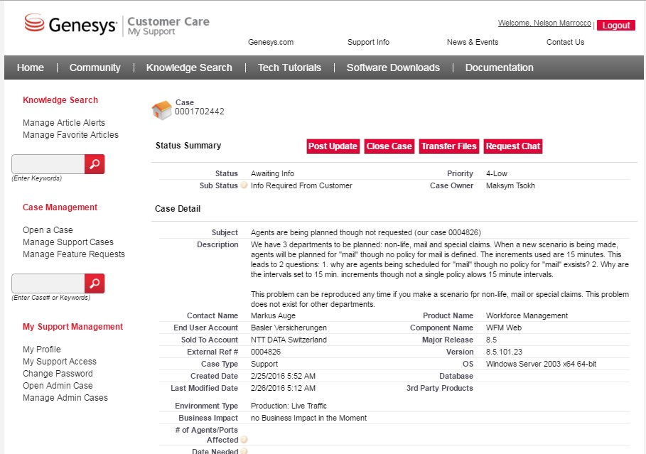


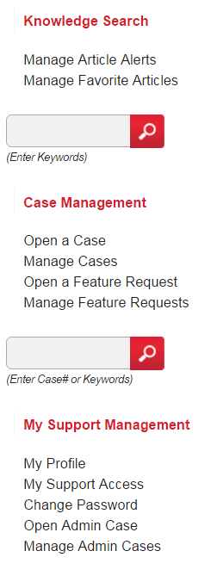


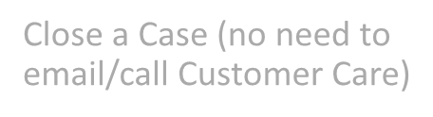

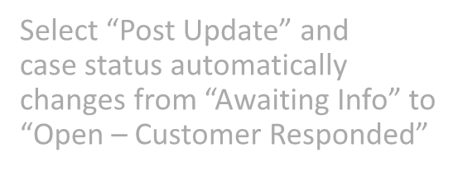
My Support: Managing Your Support Cases
Upload files that may be needed to help resolve the case
Close a Case (no need to
email/call Customer Care)
Select “Post Update” and
case status automatically changes from “Awaiting Info” to “Open – Customer Responded”

Slide 17
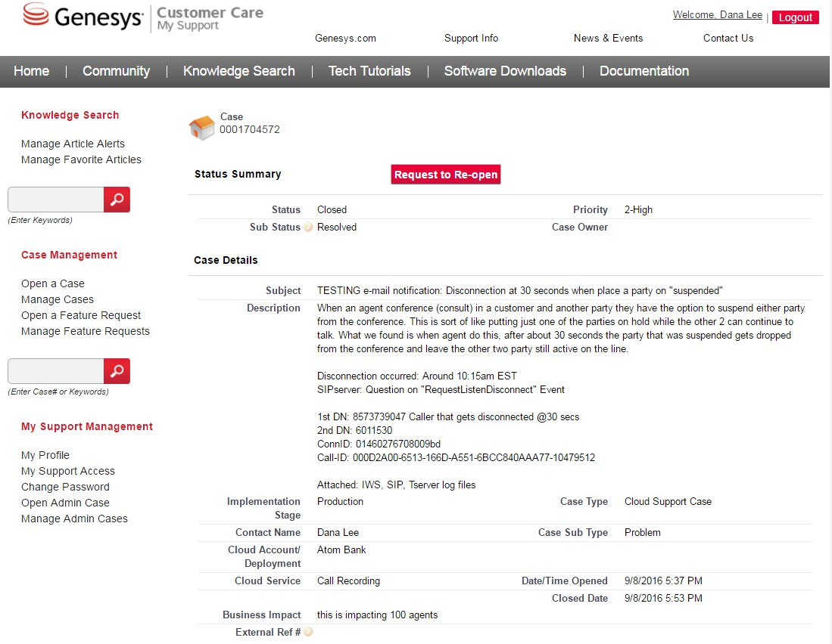


My Support: Re-opening a Closed Case
To re-open a Closed Case, select the Closed Case and select Request to Re-open

Slide 18
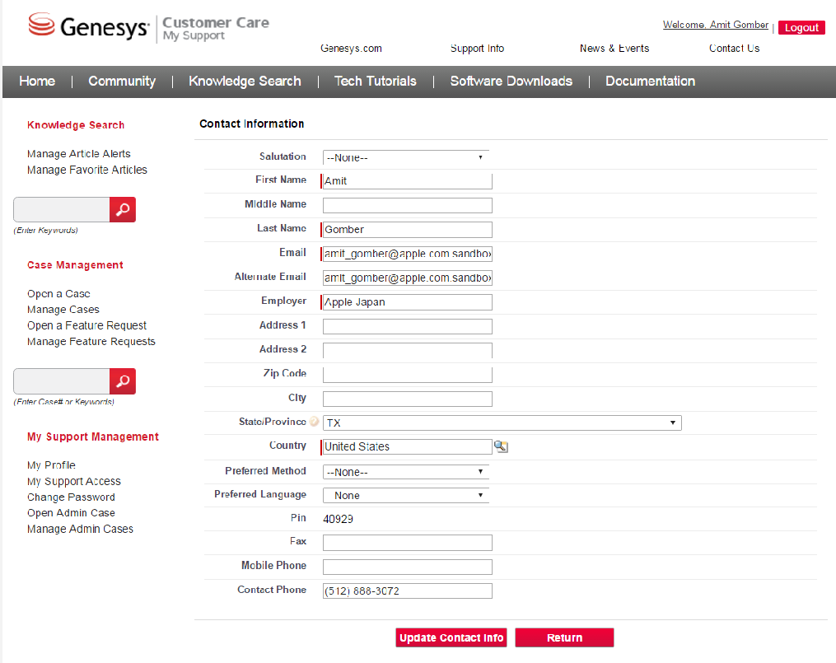




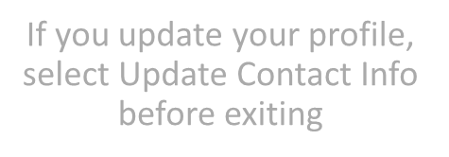
My Support: Managing Your My Support Profile
My Profile displays your personal account information
Location of your IVR Code
IVR Cod
e
If you update your profile, select Update Contact Info before exiting
Genesys confidential and proprietary information.
Unauthorized disclosure is prohibited.
23

Slide 19
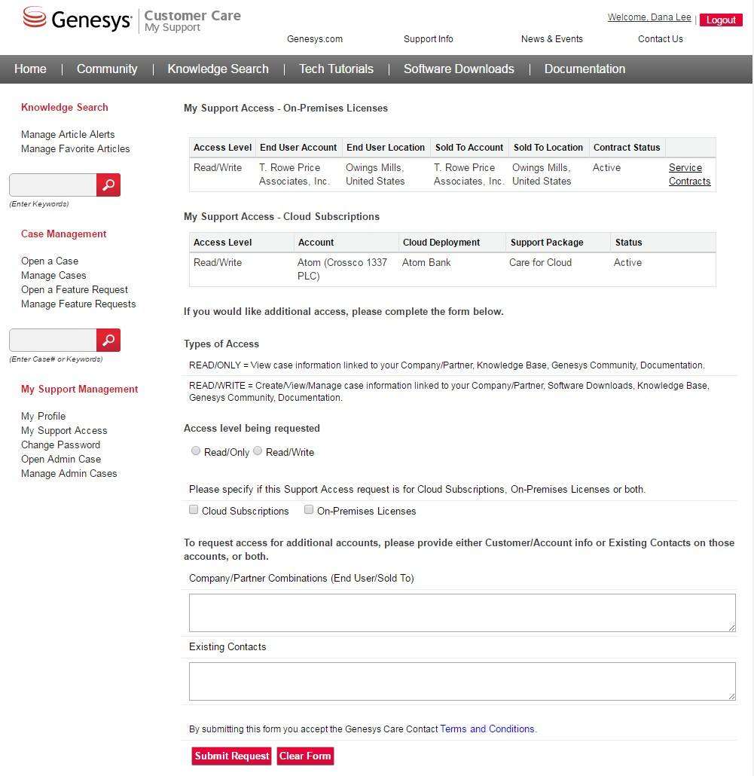

My Support: Viewing Your My Support Access
My Support Access displays the access levels for all users at your organization

Slide 20
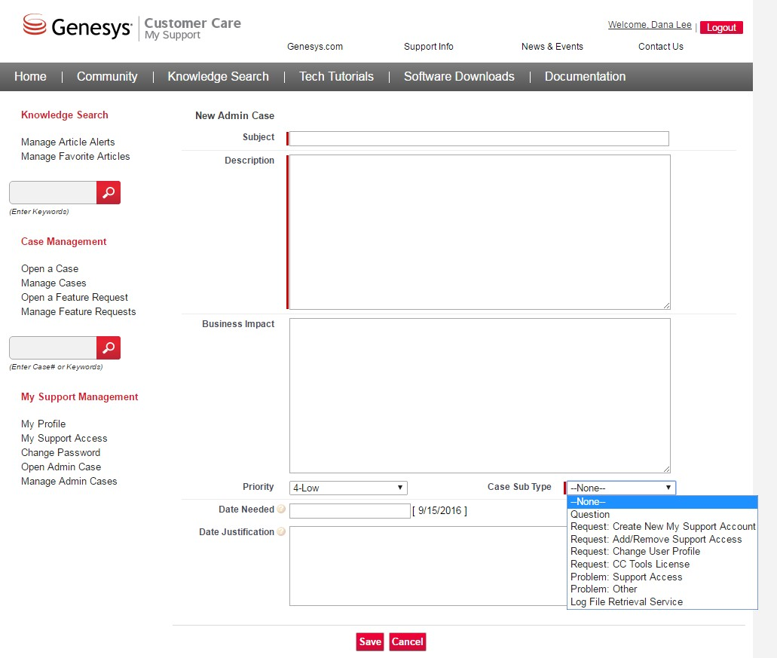

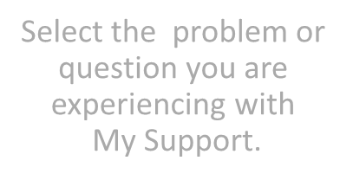

My Support: Opening an Admin Case
Select the problem or question you are experiencing with
My Support.
Select Open Admin Case for questions and issues related to My Support problems and requests
As a reminder, Open a Support Case or Service Request for problems and requests for PureCloud

